Slide 1


Understanding Performance Problems in Deep Learning Systems
Junming Cao, Bihuan Chen, Chao Sun, Longjie Hu, Shuaihong Wu, Xin Peng
Fudan University
Presenter: Junming Cao
Artifact: https://dlperf.github.io/
Notes:
Hello everyone.
I am Junming Cao, from Fudan University.
I am very glad to present our paper,“Understanding Performance Problems in deep learning systems”here.
So let’s get started.

Slide 2

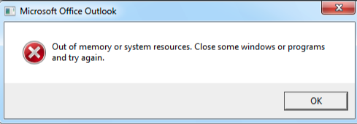
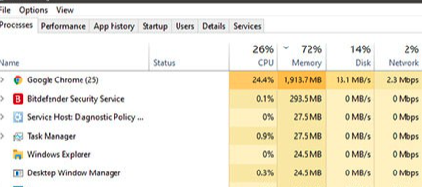
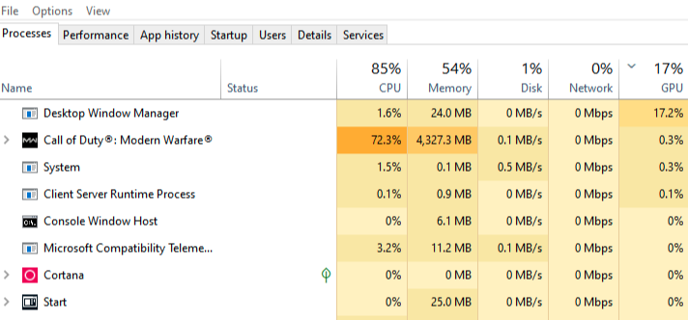
Performance Problems in General
Notes:
I believe most of you have encountered such problems,like the browser could not respond for a long time, a program crashs due to an out of memory error.
$
And a program occupies too much CPU and memory resource, or a 3A computer game fails to utilize GPU effectively to render graphics.
Thay are all performance problems, and are what I am going to talk about today.

Slide 3
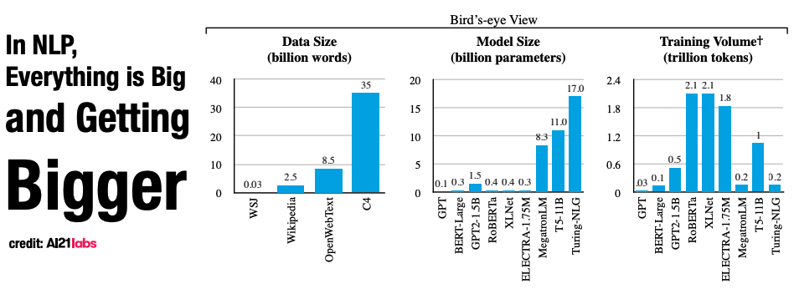
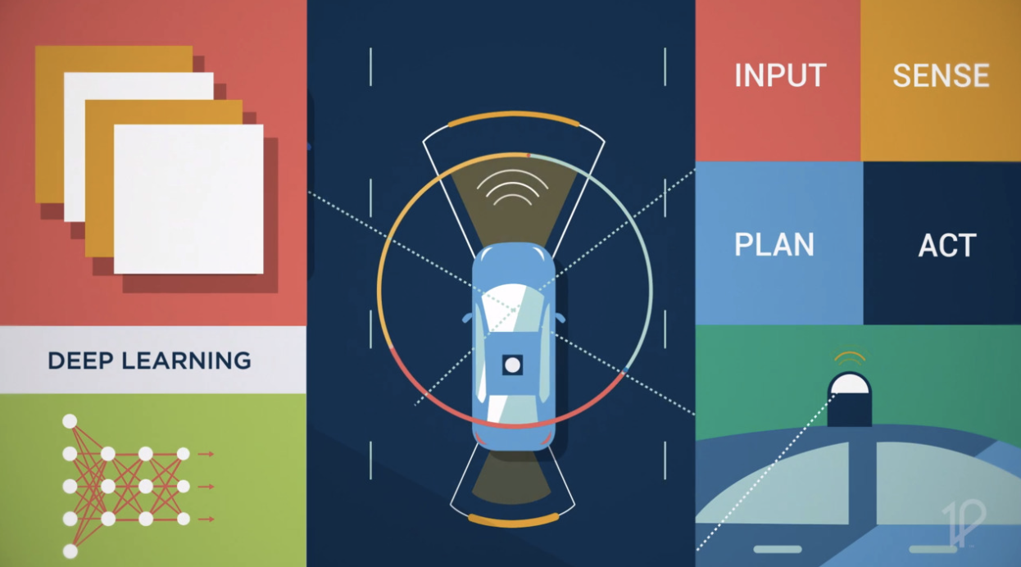
Performance in Deep Learning
Follow the definition from software engineering community, “performance” here refers to speed and memory consumption of software, not the accuracy of models.
Why performance in deep learning is important?
Expensive Training Cost
Real-time Response
Low memory resource
Notes:
We adopt the definition of “performance” from Software Engineering community, as speed and memory consumption of software.
Although the accuracy of deep learning models typically draws the most attention of researchers, performance is also critical for successful DL systems mainly due to two reasons.
Firstly, DL models are becoming larger and larger, and the training cost for such large models is expensive even for famous companies.
Secondly, to deploy DL models to real world safety-critical applications, like automonous driving cars, DL models need to response in real time with low memory resource available.

Slide 4
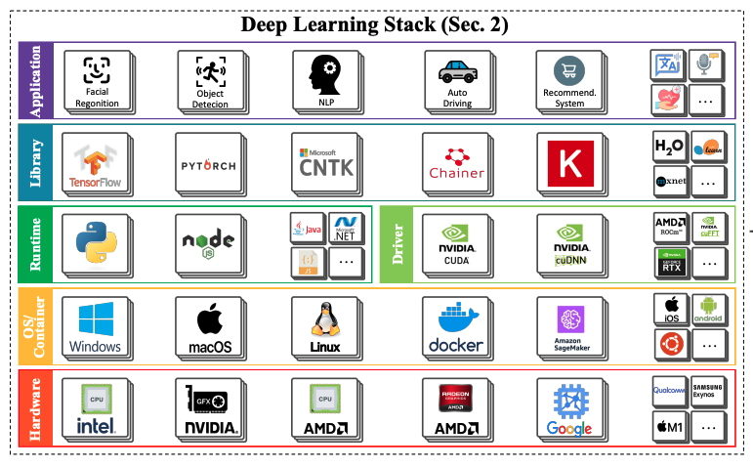
Performance in DL Stack
Techniques to improve performance:
Model Pruning,
Model Compression
Efficient Models
Efficient DL operators
Clever Compilers
Efficient GPU parallel
computation algorithms
More powerful hardware
Notes:
This is a deep learning stack figure, from the highest application layer, to lower library, runtime, OS and lowest hardware layer.
To improve the performance of deep learning systems, researchers from machine learning community and system community proposed algorithms and techniques at different layers, including model pruning,model compression at application layer, and clever compilers at library layer.

Slide 5

Performance Problems in DL
Performance problem: unexpected speed or memroy consumption of software, and
cannot be optimized away by state-of-art compilers. (Jin et al. 2012)
Where is the
root cause?
Notes:
Unfortunately, there may still be performance problems that could not be addressed by efficient models and clever compilers,
because of incorrect coding or environment settings.
We follow the definition of performance problems in the literature, as “unexpected speed or memroy consumption of software, and
cannot be optimized away by state-of-art compilers”.
It is hard to diagnose the performance problems due to the complexity of DL stack.
The root cause may lie in any layer
$
or the interaction between layers.
$

Slide 6
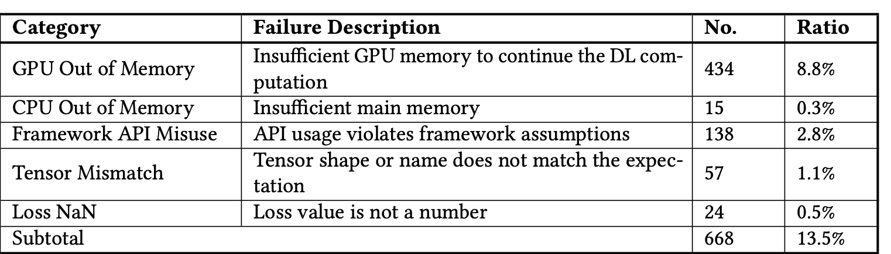
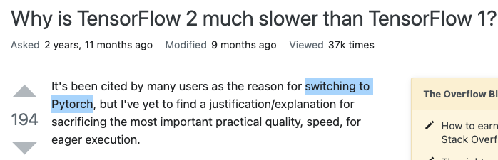
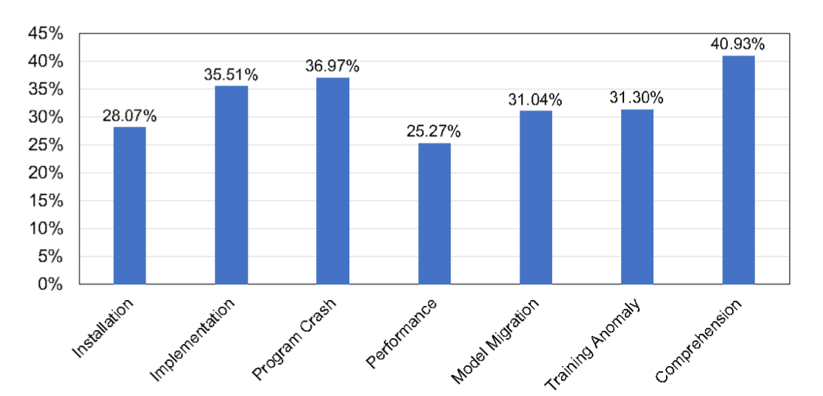
Performance Problems in DL
Widespread
[Zhang et al. 2020], Empirical study from Microsoft
Critical
Hard to diagnose
[Zhang et al. 2019], Empirical study from StackOverFlow
Fewest accpeted answer ratio
Notes:
According to an empirical study from Microsoft, most deep learning specific failed jobs in Microsoft are caused by performance problems (GPU and CPU out of memory)
Besides the performance problems of TensorFlow 2.0 cause developers to switch to Pytorch.
And performance related posts have fewest accepted answer ratio in Stack Overflow.
In summary, performance problems in deep learning are widspread, critical and hard to diagnose.
Although there have been research on performance problems in traiditonal software, we conducted the first study on performance problems in DL systems.
[1] An empirical study on program failures of deep learning jobs
[2] An Empirical Study of Common Challenges in Developing Deep Learning Applications

Slide 7
Overview of This Paper
Empirical Study. Collected data from StackOverflow to answer
RQ1: ﻿what are the symptoms of performance problems (PPs)?
RQ2: ﻿what are the root causes of PPs?
RQ3: ﻿what are the stages of introducing and exposing PPs?
Benchmark. Constructed a reproducible benchmark to
﻿Assess the capability of existing performance analysis techniques in tackling PPs
Facilitate the evaluation of PP detection, localization and fixing tools
Detection Tool
Developed a static checker with three rules from empirical study to detect PPs
Evaluated the tool with benchmark and real world Github projects
Notes:
This paper can be divided into three parts.
Firstly, we collected data from StackOverflow to invesigate the symptoms, root causes and stages of PPs.
Secondly, we constructed a reproducible benchmark to assess the capability of existing performance analysis techniques.
Thridly, we developed a static checker with three rules from empirical study to detect PPs.
I will present the three parts in order.

Slide 8
Empirical Study: Data Collection and Labeling
﻿Data Collection:
Step 1: DL Post Selection (obtained 18,730 DL posts)
Apply tag filter (“tensorflow” and “keras”)
Apply time filter (2018-2021), no source code filter, accpeted answer filter
﻿Step 2: PP Post Selection (obtained 742 candidate DL PP posts)
Apply keywords filter that derived iteratively
﻿Step 3: PP Identification (obtained 224 PPs with 210 DL PP posts)
Remove posts that are without correct answers, not PP related manually
Data Labeling:
﻿Three dimensions: symptom, root cause, and introducing and exposing stages
Notes:
We followed three steps to collect the data for empirical study from Stackoverflow.
After applying various filters in step 1 and step2, we manually identified PP related post, and finally obtained 224 PPs with 210 posts.
There are 14 posts with two PPs identified.
After that, ﻿we labeled each of the 224 PPs with respect to three dimensions: symptom, root cause, and introducing and exposing stages.

Slide 9
Results: Symptom Analysis (RQ1)
Performance Problems (224)
Time (126)
Memory (56)
Slow Execution Time (99)
Slow Initialization Time (6)
Out of Memory (37)
Memory Leak (16)
Increasing Time Over Time (16)
Program Hang (8)
Abnormal GPU Memory Usage (5)
Processor (16)
Unknown (45)
Abnormal GPU Utilization (8)
Not Using GPU (4)
Abnormal CPU Utilization (4)
Notes:
This is the t﻿axonomy of PP symptoms in RQ1.
﻿It is organized into three high-level categories.
Only 10 symptoms with dotted rectangles, are shared with the existing symptom taxonomies for general DL bugs.
﻿More than half of the PPs slow down DL systems, and nearly one-third of the PPs consume either extremely low or high resources like memory and processor.

Slide 10
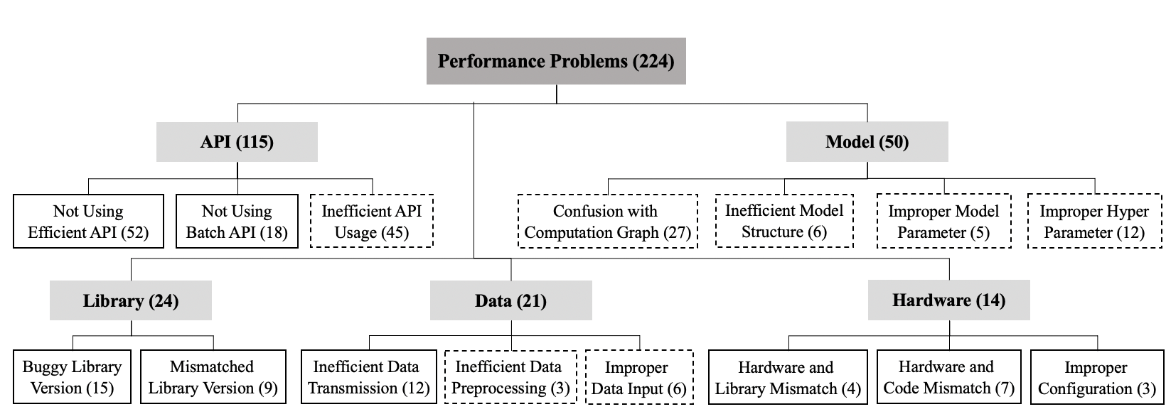
Results: Root Cause Analysis (RQ2)
Notes:
﻿For RQ2, The taxonomy of PP root causes is showed in this figure. It is grouped into five high-level categories.
﻿Only seven of the 15 root causes, as shown in dotted rectangles, are the same to the previous root cause taxonomies for general DL bug.
﻿About half of the PPs are introduced by API misuses.
Model, data and hardware introduce more than one-third of the PPs.
﻿These diverse sources of root causes increase the complexity of PP localization.

Slide 11
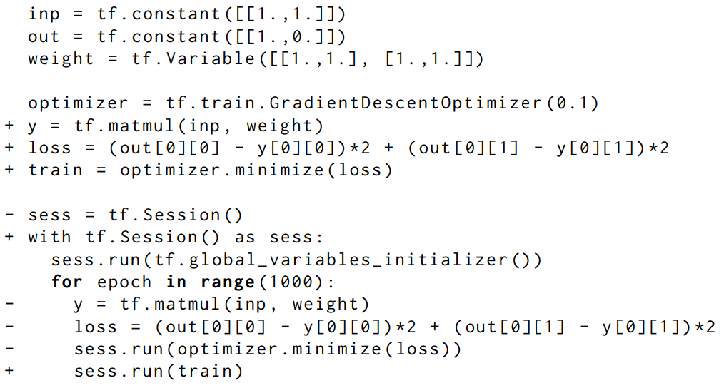
Example1: Confusion with Computation Graph
Define and Run
Notes:
Let’s see an example of PP caused by confusion with computation graph.
In TensorFlow 1, developers need to ﻿first build a dataflow computation graph and then run it repeatedly with inputs being fed to and outputs being fetched
from the graph.
﻿Developers often mix the graph construction into the graph execution. As a result, nodes are repeatedly added to the graph, and the graph execution becomes slower and slower.
As the figure shows, the developer defined the loss and optimizer inside the session, and created these two nodes for 1000 times.
They should be moved outside the tf Session.

Slide 12
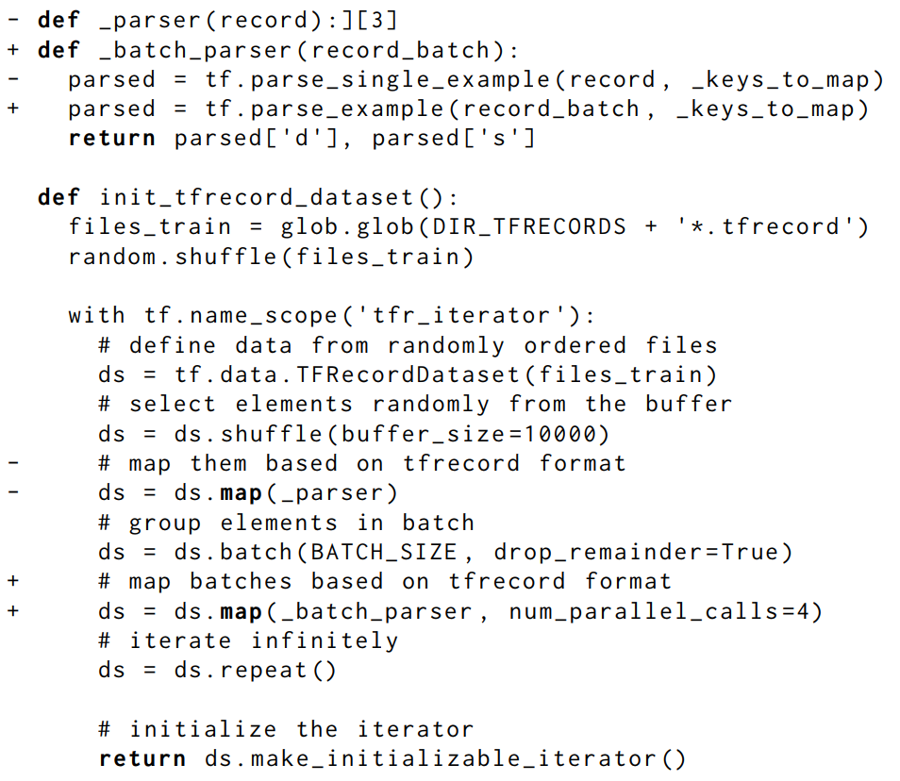
Example2: Inefficient API Usage
Batch then Map
Map with num_parallel_calls
Notes:
The second example is about a PP caused by inefficient API Usage.
﻿The map API should be called after batch API to reduce the number of times the mapped function _batch_parser is called, and num_parallel_calls should be passed to enable parallelism of map API.

Slide 13
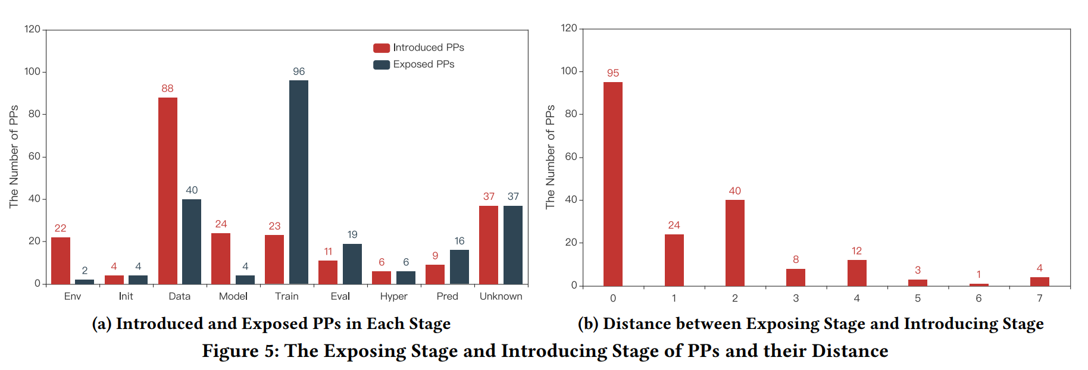
Results: Stage Analysis (RQ3)
PP Introduced Stage (Root cause stage); PP Exposed Stage (Symptom Stage)
Environment Setting->Initialization->Data Prepraration->Model Building
->Training->Evaluation->Hyperparameter tuning->Prediction
Notes:
We divided the DL pipeline into 8 stages from environment setting, initialization to prediction and a unknown stage if developers did not specify it explicitly in posts.
PP introduced
The left figure shows the number of introduce and exposed PPs in each stage.
﻿Data preparation is the most bug-prone stage, which is blamed in 88 (almost 40%) of the PPs.
﻿Training and data preparation are the two most bug-affecting stages.
The right figure shows ﻿the distance between PP’s exposing stage and introducing stage.
﻿Intuitively, the larger the distance, the more difficult to localize a PP from its symptom to root cause.

Slide 14
Benchmark Construction
Step 1: Decide TensorFlow Version
From question descriptions and answers
From version-specific APIs (e.g., tf.Session for TF1.x, @tf.function for TF2.x)
﻿Step 2: Complete Code Snippets
From executable buggy or fixed code version
From answers and external urls if available (e.g. Github repo url)
﻿Step 3: Reproduce Symptoms
May change input data size and model parameters, etc.
to reproduce described symptoms
Finally reproduced 58 PPs from 112 sampled PPs, cover all symptoms and root causes, except for Hardware related PPs. All of them can be executed and reproduced with Docker.
Notes:
﻿After the empirical study, we constructed a benchmark by reproducing PPs.
We followed three steps to reproduce 58 PPs from 112 sampled PPs successfully.
Some PPs failed to be reproduced due to harware requirements.

Slide 15
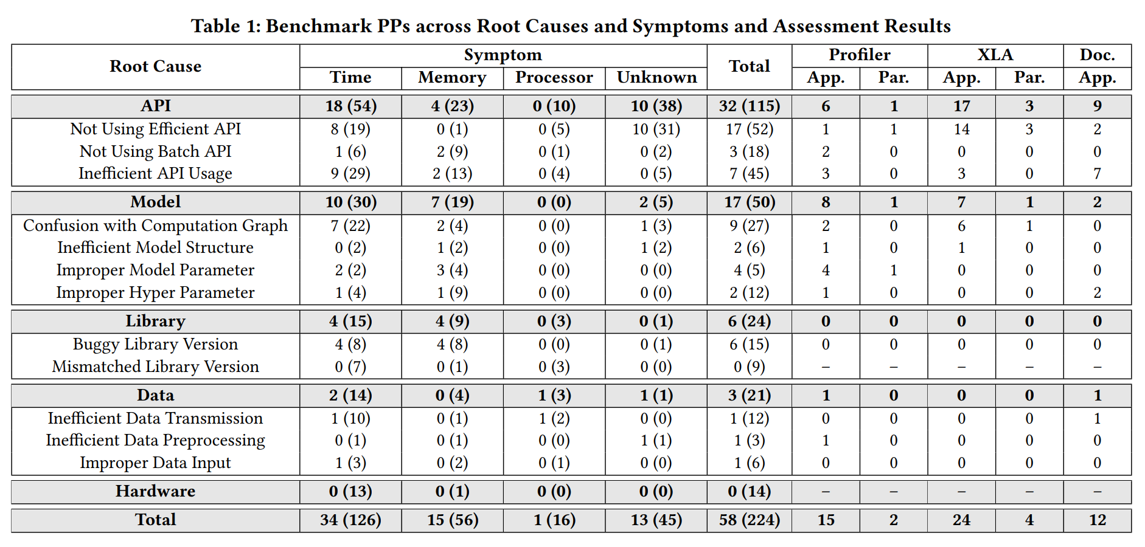
Approach Assessment
Assessment of three performance analysis techniques with benchmark: TensorFlow Profiler, XLA, and TensorFlow Doc
Applicable: whether a PP is in the capability scope of a technique
Solvable: whether a PP can be solved by a technique
Notes:
﻿To the best of our knowledge, there is no existing direct PP detection and localization approach for DL systems.
﻿Thus we select and assess three typical performance analysis approaches,which can help developers ﻿identify PPs indirectly, with previous constrcuted benchmark.
﻿Generally, we assess each technique in two dimensions, ﻿whether a PP is in the capability scope of a technique, and whether a technique can solve a PP.
As shown in the table, three techniques are applicable to less than half PPs and can partially solve 6 of them in total.

Slide 16
Detection Tool Implementation
Implement the tool through static analysis
with Python AST and Jedi
Checker2: Inefficient order of batch and map
Checker3: Disabled Parallelism of map and interleave
Example2: Inefficient API Usage
Checker1: Repeated Node Creation
Example1: Confusion with Computation Graph
Notes:
﻿To demonstrate the usefulness of our findings, we implement a rule-based static checker to detect PPs through static analysis.
For PPs caused by repeated node creation in computation graph, we check whther APIs that create computation nodes care called repeatedly with same argumaents.
$
And we simply check the order of batch and map, and the num_parallel parameters to detect PPs caused by them.

Slide 17
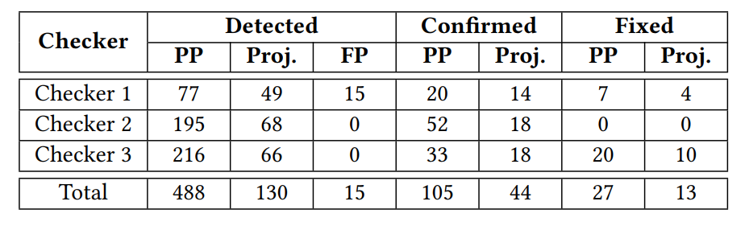
Detection Tool Evaluation
Evaluation on Benchmark
3, 2, 2 of 4, 2, 2 PPs are detected by three checkers, respectively
1 false positive of Checker 1 is caused by the limitability of type inference of Python
Evaluation on Github Projects
1108 Github projects using TensorFlow, with at least 100 stars
Detected 488 new PPs in 130 projects. 105 and 27 PPs have been confirmed and fixed.
Notes:
We evaluate the detection tool with benchmark and Github Projects.
In spite of the simpicity of the tool, it has detected lots of PPs in Github. ﻿105 and 27 PPs have been verified and fixed by developers.

Slide 18
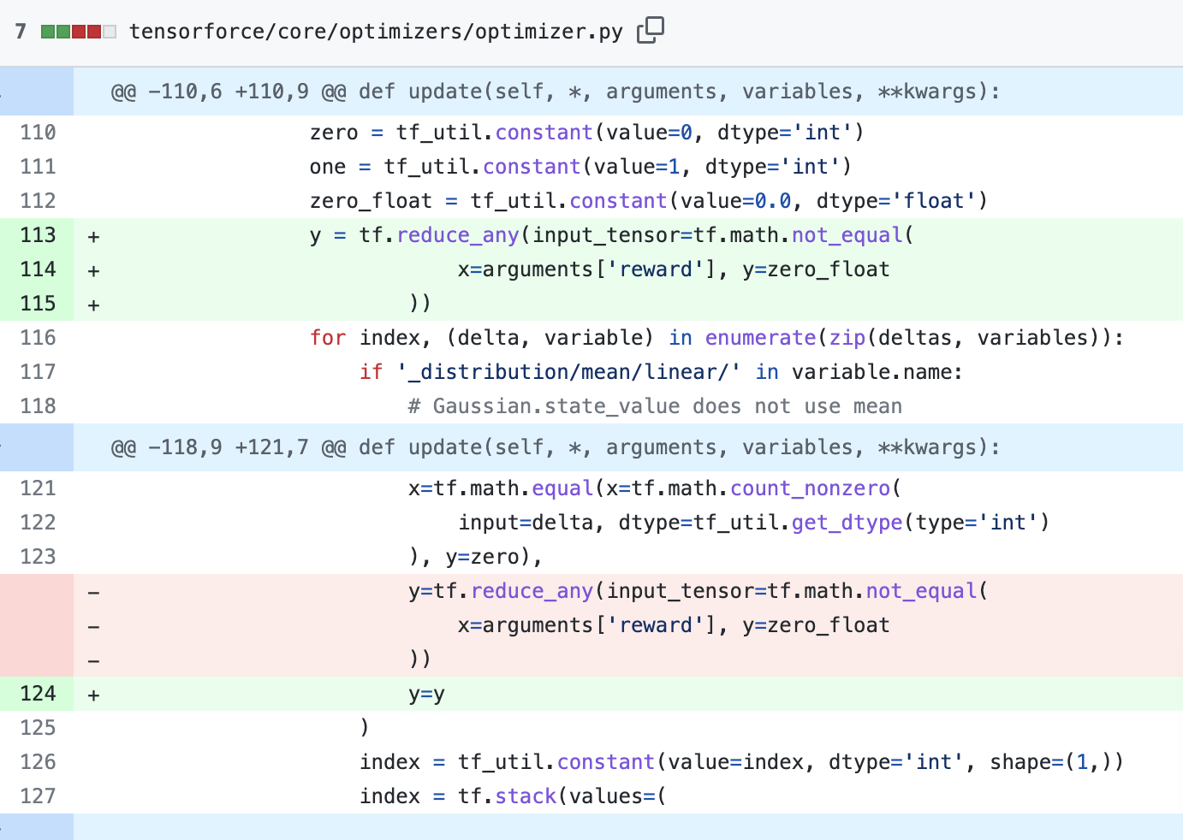
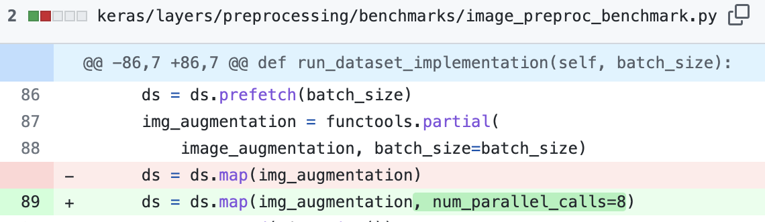
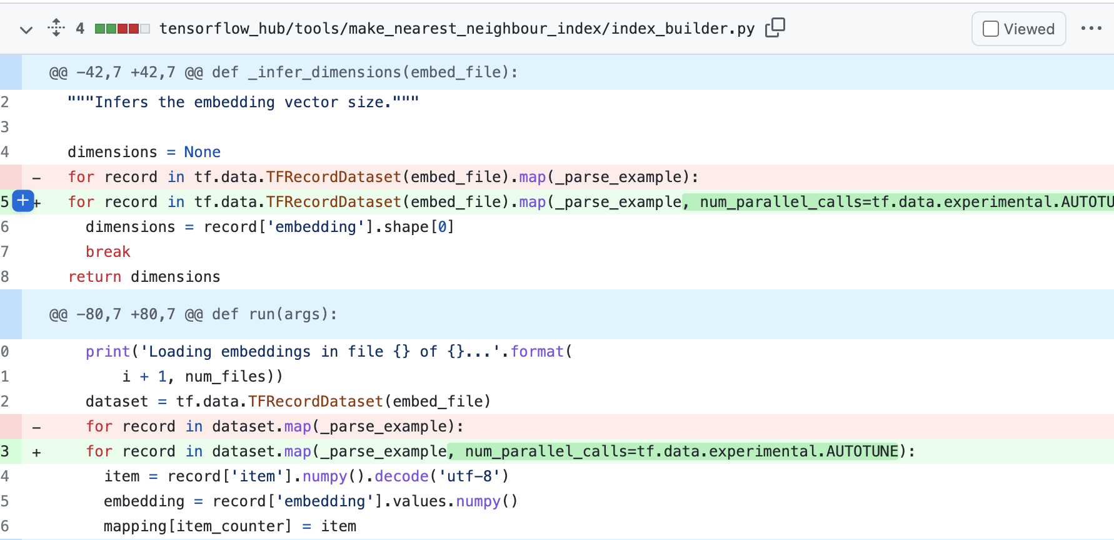
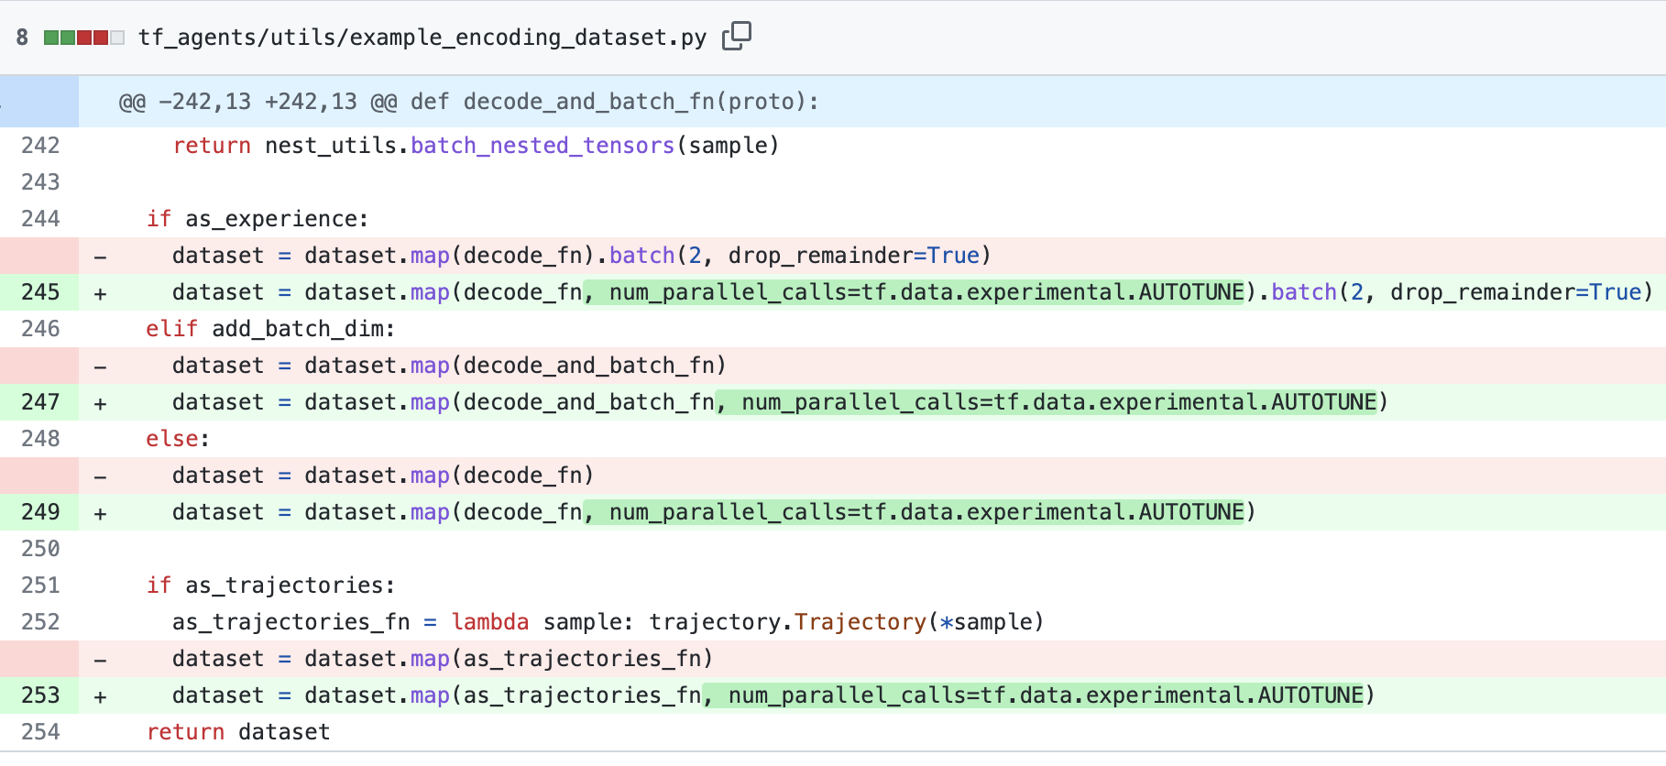
Examples of Fixed PPs from Github Projects
Keras
TensorFlow Hub
TensorFlow Agent
TensorForce
Notes:
Here are some examples of fixed PPs from well-known projects, like Keras, TensorFlowHub, TensorForce and TensorFlow Agent.
https://github.com/keras-team/keras/pull/15295
https://github.com/tensorflow/hub/pull/843/files
https://github.com/tensorforce/tensorforce/pull/816/files
https://github.com/tensorflow/agents/pull/650/files

Slide 19
Implications
For Developers:
Provide the knowledge of common root causes of PPs, bug-prone stages and bug-affecting stages.
Understanding of the performance of library APIs and computation graph is necessary to write high performance deep learning programs.
For Researhcers:
﻿Intelligent techniques for high performance DL system development are needed (e.g., performance aware API recommendation, DL librarys, DL models suggestion).
﻿PP detection techniques are needed (lack of test oracles).
﻿PP localization techniques are needed (PP introduced stages are not exposed stages).
Notes:
Both developers and researchers can benefit from our study.
For developers, we provide the knowledge of common root causes of PPs, thus they can write more efficient DL programs and debug performance problems more easily.
For researchers, our study shows intelligent techniques for high performance DL system development, PP detection techniques and PP localization techniques are needed

Slide 20
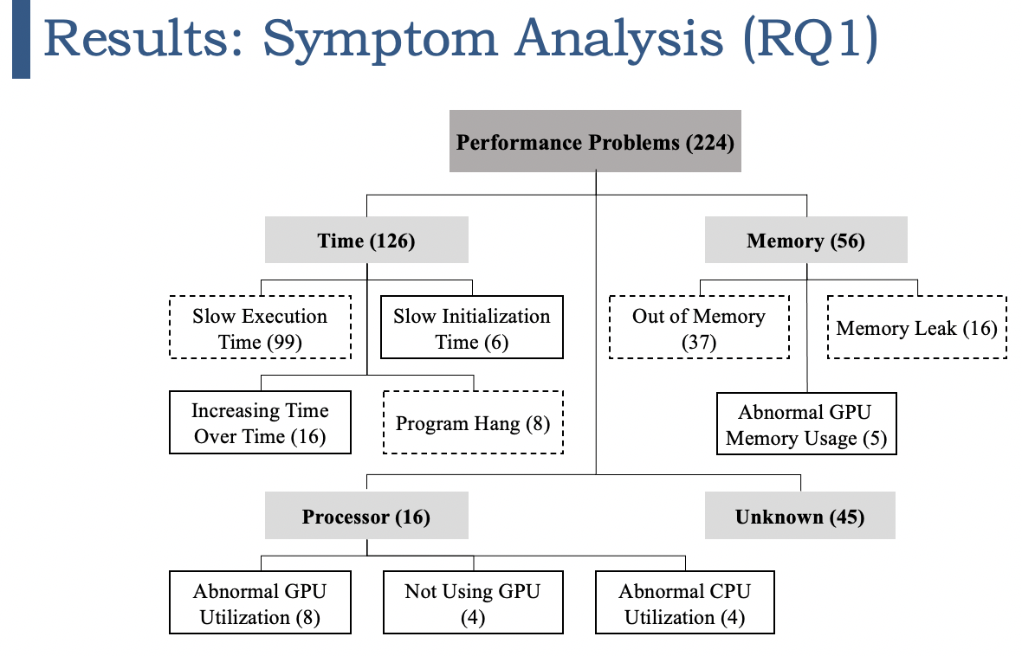
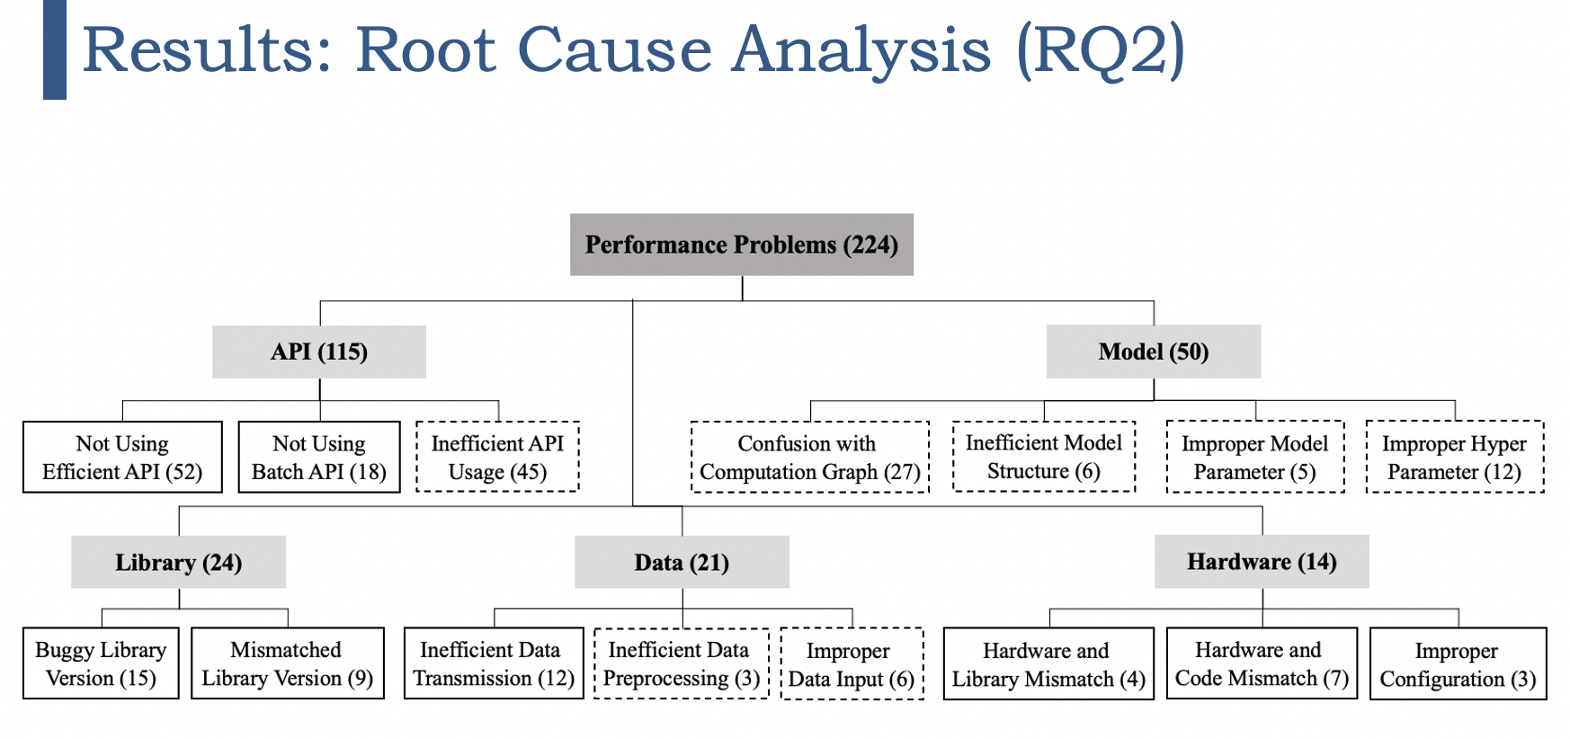
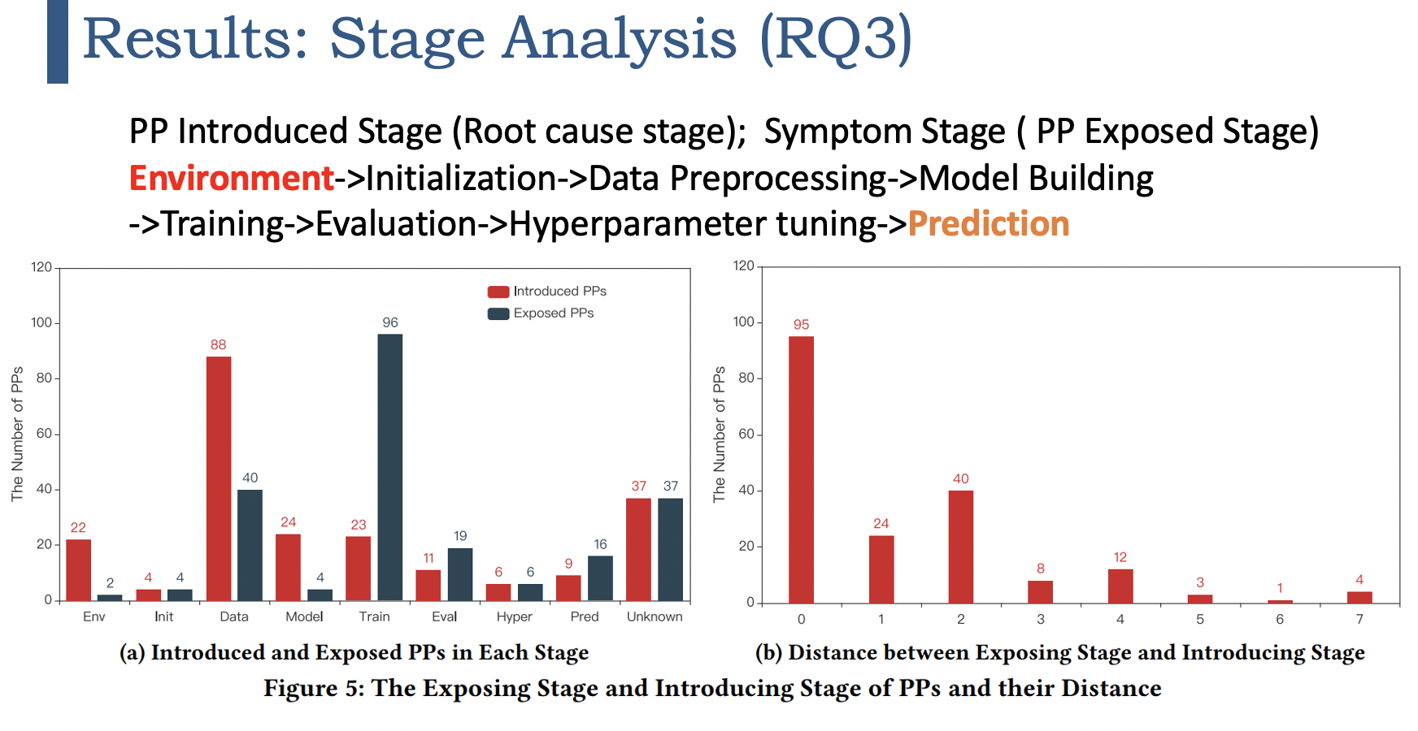
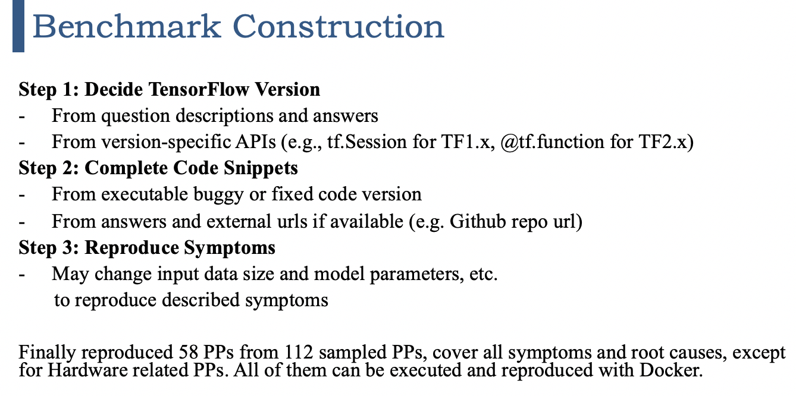
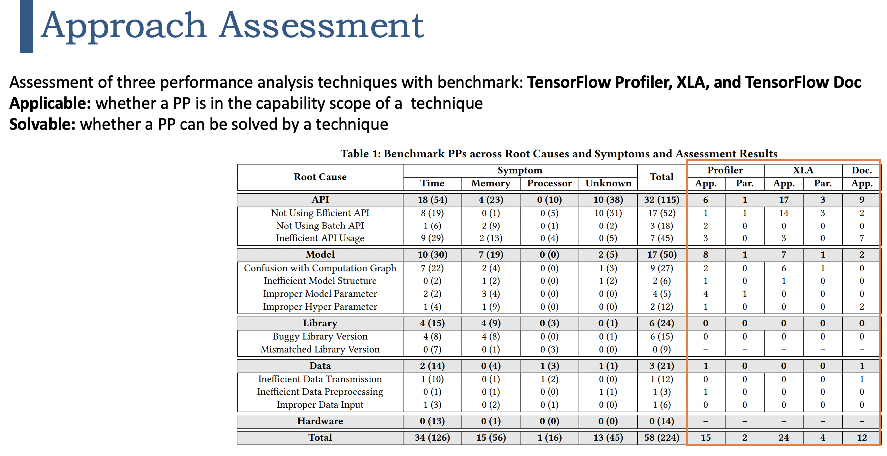
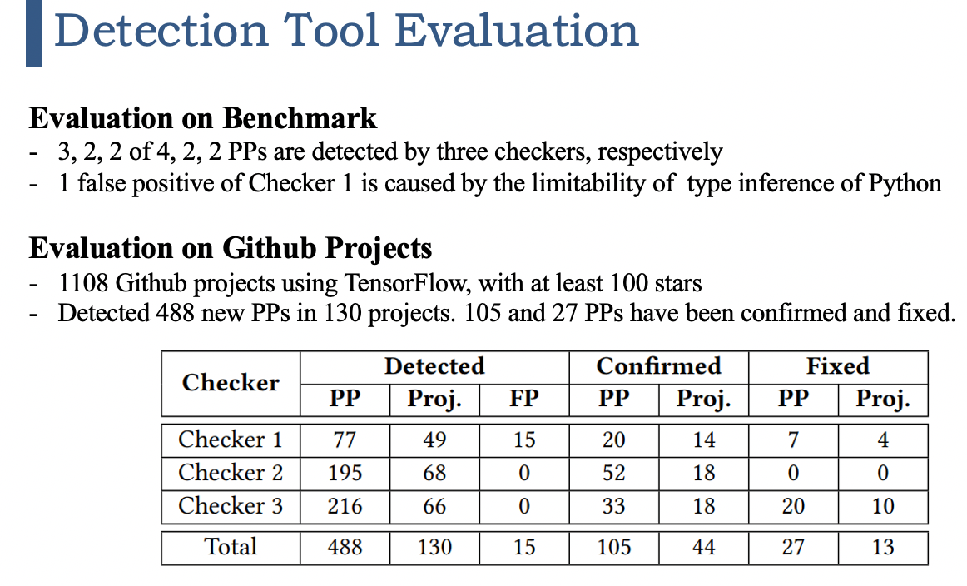
Conclusion (to remove PP detection tool title)
Notes:
In conclusion, we first conducted an empirical study to investigate the symptoms, root causes, stages of PPs in DL sysmtems.
And then constucted a reproducible benchmark to assess existing three performance analysis techniques.
Finally, we developed a PP detection tool and detected PPs in real world Github projects.

Slide 21
Thank you!
Notes:
Thank you, that’s all my presentation.

